Slide 1
Lesson – 8
Neural Network: An inspiration from Human Brain

Slide 2
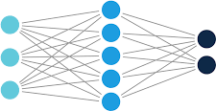
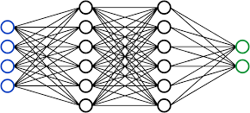

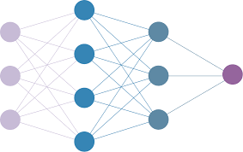
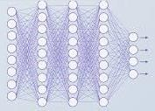


Slide 3
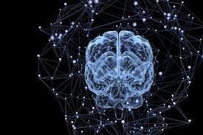
Network of neurons in Human Brain

Slide 4
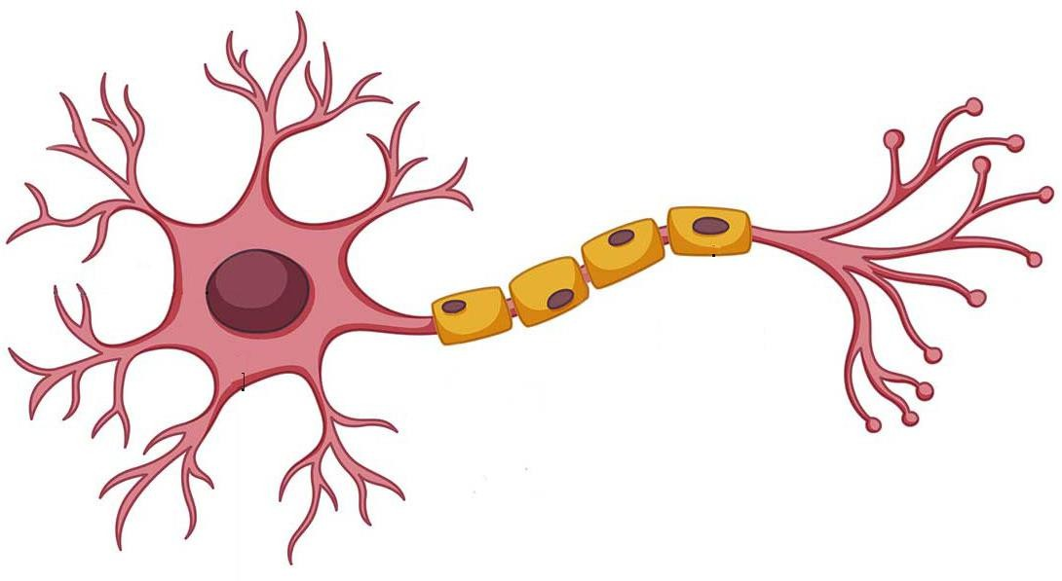
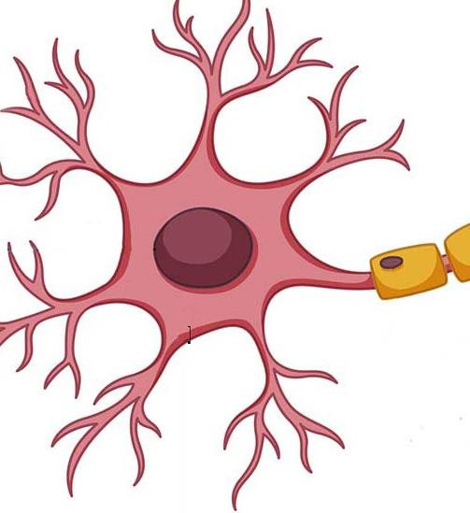
Dendrites
Cell Body(Soma)
Axon
Axon Terminal (Synapses)
Nucleus

Slide 6


Slide 7
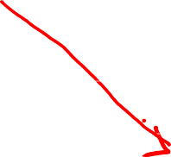



Slide 8




Slide 9




Slide 10


Slide 11


Slide 12


Slide 13
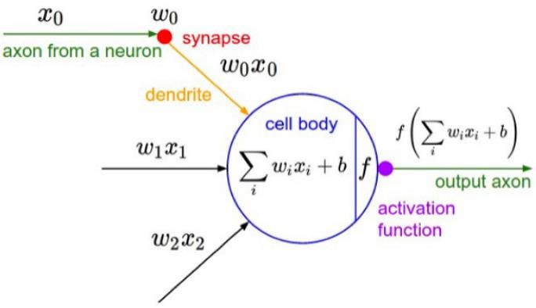
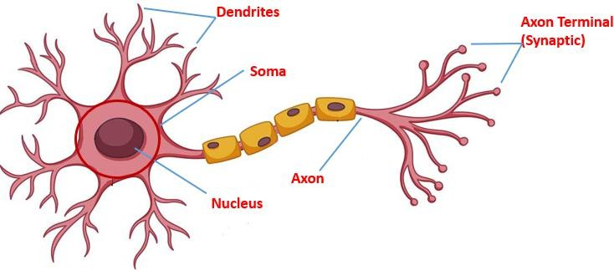
Network of neurons
Network of neurons

